Slide 1
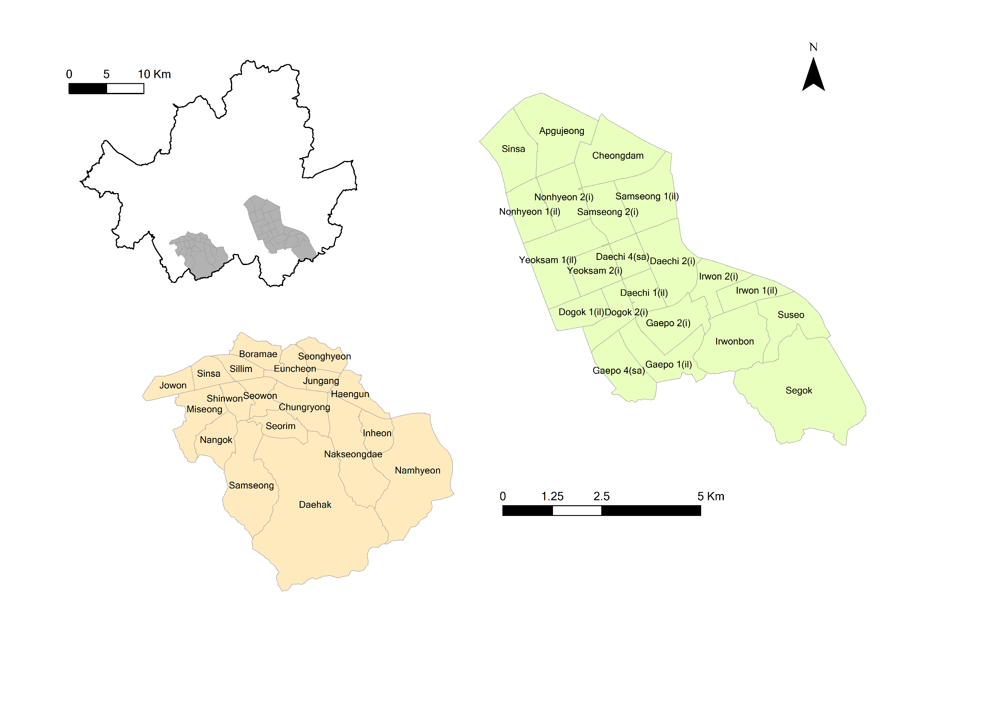
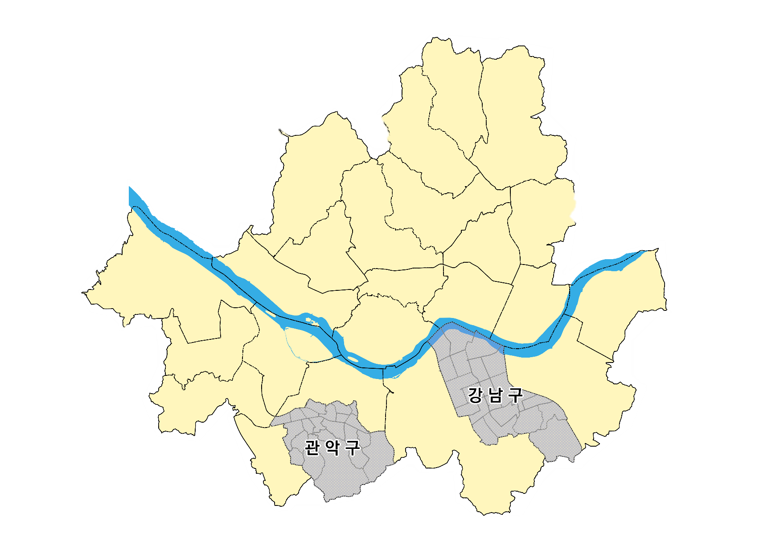
605 km²
Gangnam
Gangnam
Gwanak
39.5 km²
Gwanak
29.5 km²

Slide 2
① Data Collection
Admin Boundary
Pollution
Social data
Simulation update
② Agent decision
⑥ Output
Movement behaviour
Health status
Vulnerability Emergence
High risk areas
③ Vulnerability sub-model
Exposure model
Sensitivity model
Resilience model
④ Vulnerability calculation
Population Vulnerability
Vulnerability within district
Day = Day + 1

Slide 3
GIS data import
Data collection
Admin Boundary
InterpolatedPM₁₀
Census
Road
Atmospheric settings
Individual settings
PM₁₀ by Season
Agent composition & decision-making
PM10 in patches
Health
Sensitivity
Movement behaviour
Scenarios
Temporal trend of PM10
Resilience
Estimation
Calculation of PM₁₀ vulnerability
Vulnerability by age and edu
Vulnerability by district
Vulnerability within district

Slide 4
Import GIS data
Settings
Scenarios
Estimation
Data collection
Atmospheric Settings
Temporal trend of PM10
PM₁₀ vulnerability
Boundary
PM10
Census
Road
PM10 in patches
Vulnerability by age and edu
Agent settings &
decision-making
Resilience
Vulnerability by district
Health
Sensitivity
Behaviour
Vulnerability within district

Slide 5
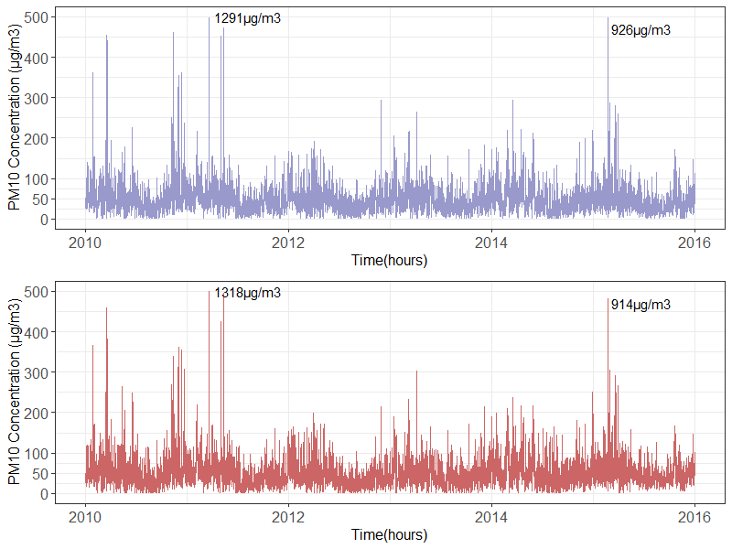
Gangnam
Gwanak

Slide 6
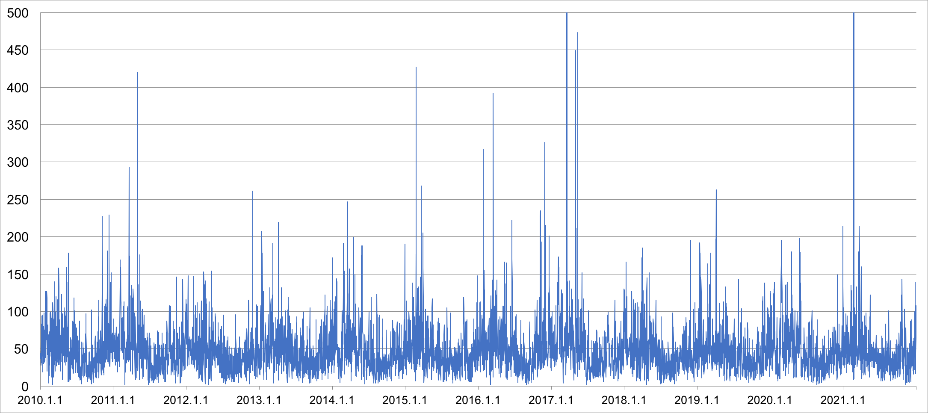
(a)
Randomly choose one of the value in the first row
No | Date | Work | h1 | h2 | h3 | h4 | h5 | h6 | h7 | h8 | h9 | h10 | h11 | h12 | h13
1 | 2010-01-01 | home | 30 | 35 | 36 | 31 | 33 | 36 | 28 | 38 | 38 | 52 | 43 | 43 | 39
2 | 2010-01-01 | work | 37 | 33 | 31 | 41 | 29 | 41 | 36 | 36 | 37 | 35 | 37
3 | 2010-01-02 | home | 39 | 37 | 38 | 40 | 43 | 39 | 41 | 40 | 99 | 85 | 83 | 77 | 70
4 | 2010-01-02 | work | 46 | 44 | 47 | 42 | 39 | 42 | 47 | 55 | 68 | 75 | 102
5 | 2010-01-03 | home | 64 | 62 | 59 | 56 | 54 | 52 | 47 | 40 | 46 | 59 | 61 | 64 | 65
6 | 2010-01-03 | work | 49 | 36 | 33 | 41 | 45 | 39 | 46 | 37 | 44 | 50 | 43
7 | 2010-01-04 | home | 57 | 48 | 54 | 51 | 44 | 37 | 35 | 36 | 34 | 62 | 54 | 44 | 45
8 | 2010-01-04 | work | 25 | 26 | 28 | 24 | 25 | 27 | 31 | 30 | 33 | 27 | 26
9 | 2010-01-05 | home | 46 | 56 | 53 | 60 | 61 | 62 | 62 | 59 | 40 | 33 | 31 | 31 | 37
10 | 2010-01-05 | work | 65 | 63 | 56 | 58 | 41 | 46 | 68 | 64 | 47 | 29 | 41
(b)

Slide 7
SCENARIO
1. Pollution scenario (BAU, INC, DEC)
Start
End of 12 years?
Update plot
Day = Day + 1
Sensitivity
Age
Education
Road Proximity
Agents move to home/work
Label agent as at risk
End
Near road?
Set additional weight on α
in equation
Health under 100?
PM₁₀ of location
over threshold?
Label agent as highly exposed
Health decrease
Recover according to local wealth measure
Health under
100, 150, 200?
Health under 200?
SCENARIO
2. Resilience scenario (AC100, AC150, AC200)
*AC (Adaptive Capacity): maximum health level to which an agent can recover

Slide 8
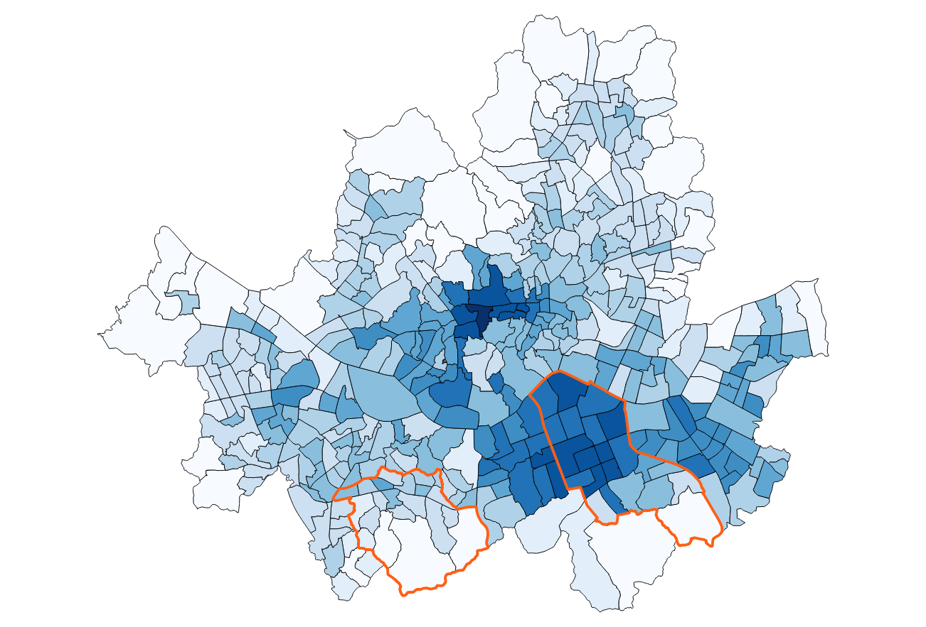
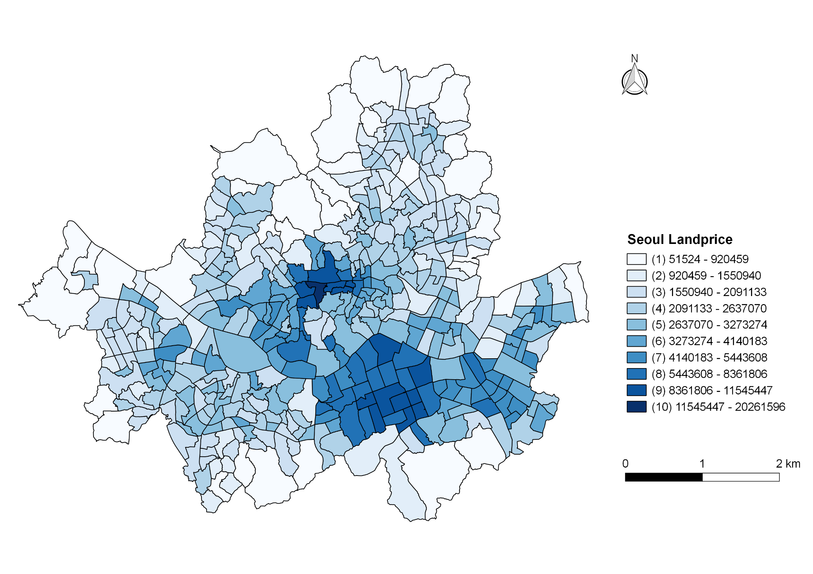
(a)
(b)
Class | Land Price (in Korean Won) | Health
1 | < 920,459 | + 0.01
2 | 920,459 - 1,550,940 | + 0.01
3 | 1,550,940 - 2,091,133 | + 0.02
4 | 2,091,133 - 2,637,070 | + 0.04
5 | 2,637,070 - 3,273,274 | + 0.05
6 | 3,273,274 - 4,140,183 | + 0.05
7 | 4,140,183 - 5,443,608 | + 0.06
8 | 5,443,608 - 8,361,806 | + 0.07
9 | 8,361,806 - 11,545,447 | + 0.12
10 | 11,545,447 - 20,261,596 | + 0.15
Gangnam
Gwanak

Slide 9
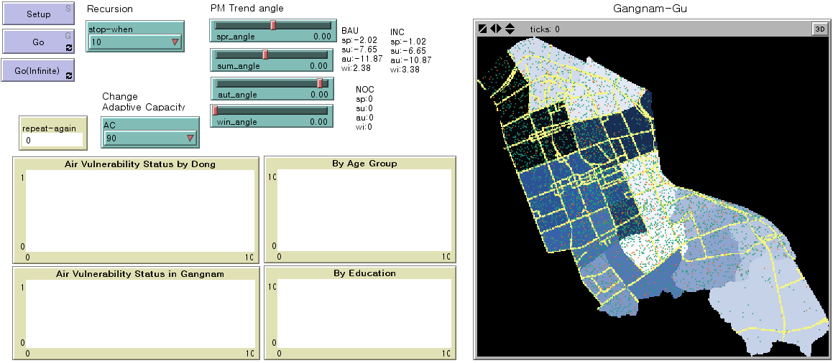
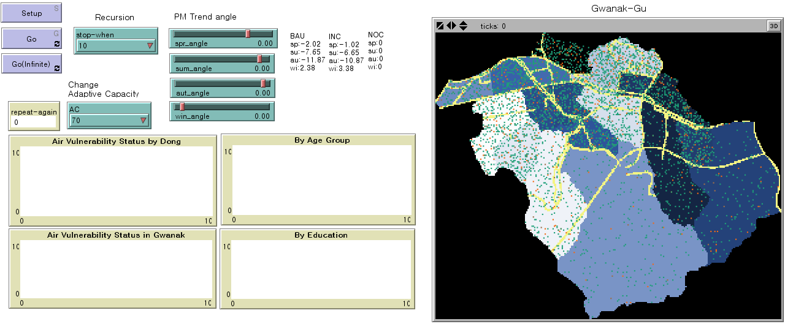

Slide 10
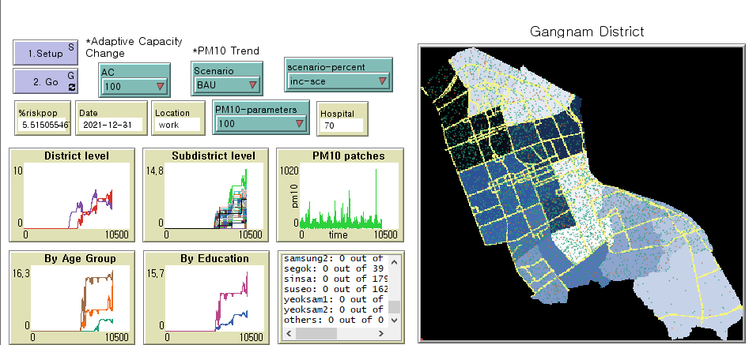
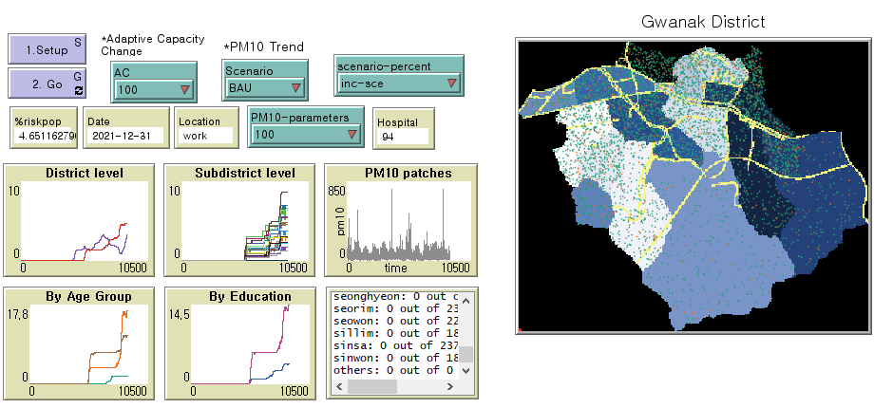

Slide 11
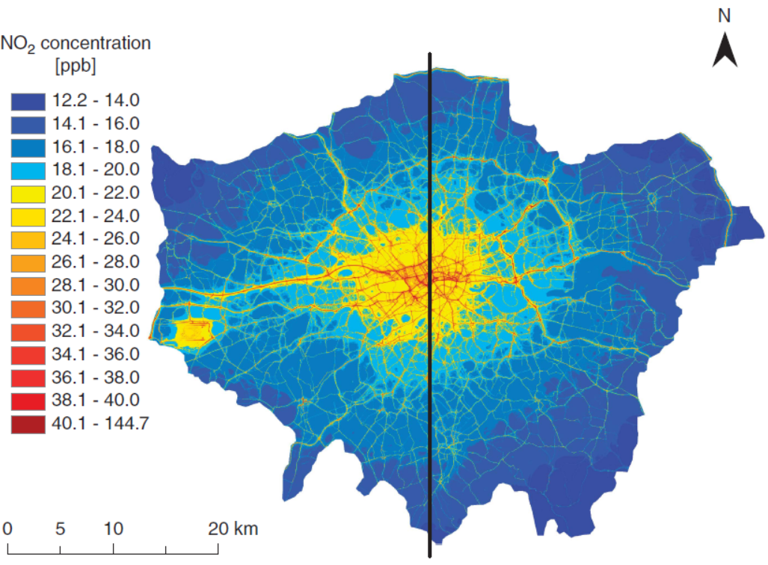

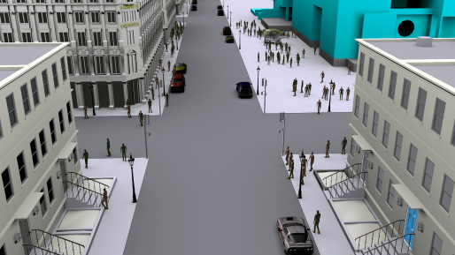



Macro(City) level
Software Vision
Meso(Neighbourhood) level
Individual level
Different situations of exposure in daily life
1
2
3
Walking
In-Vehicle
In-Building

Slide 12
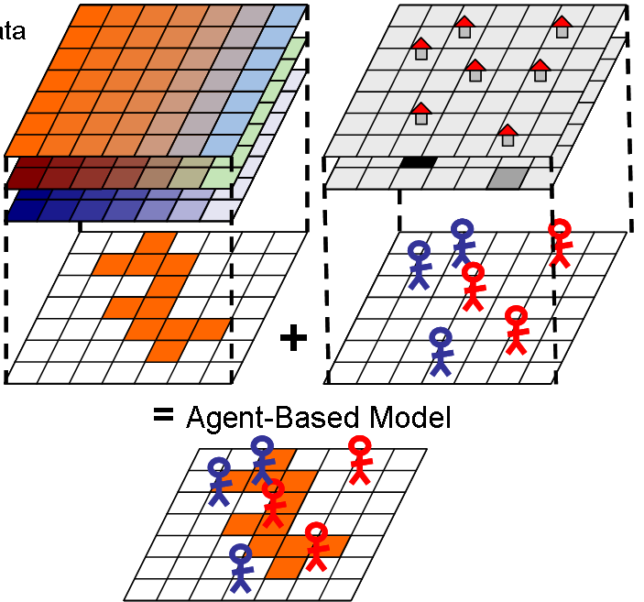
Environmental factors
- Pollution (PM₁₀)
Social factors
- Road facilities
Agents
- Age
- Education
- Moves (O/D Matrix)
A conceptual model of ABM (Rebaudo et al., 2011)

Slide 13
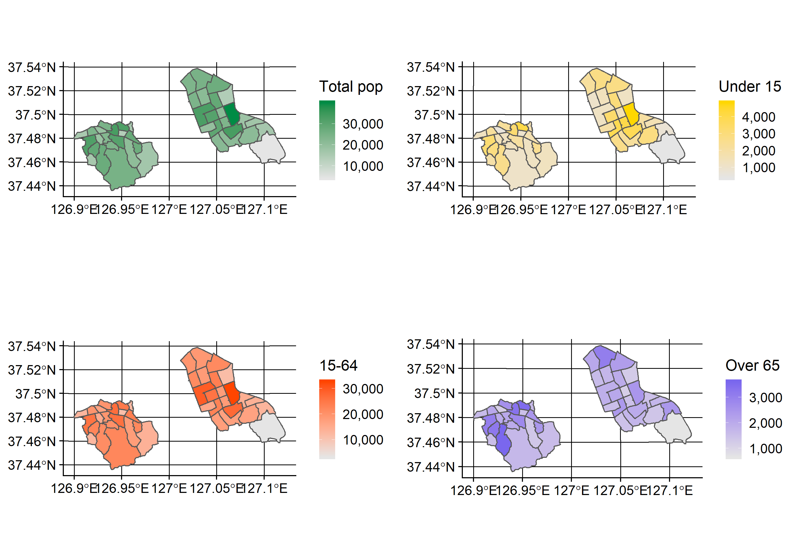

Slide 14
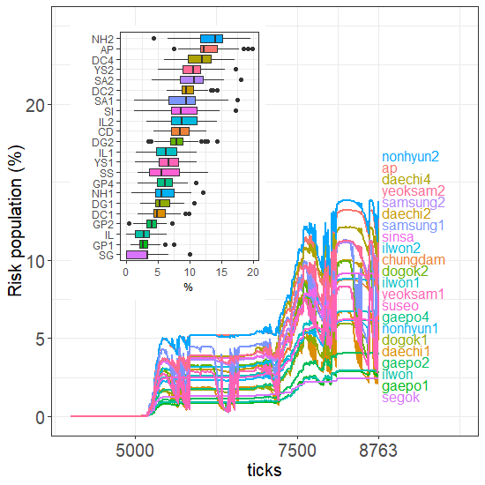
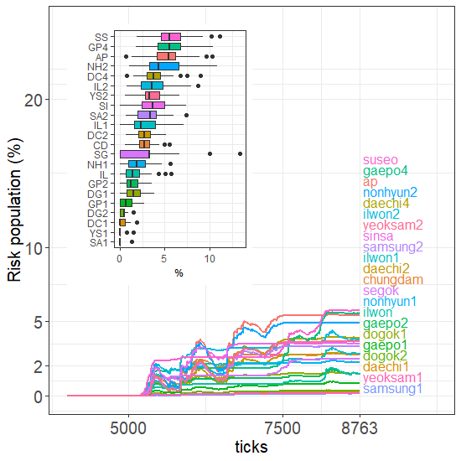
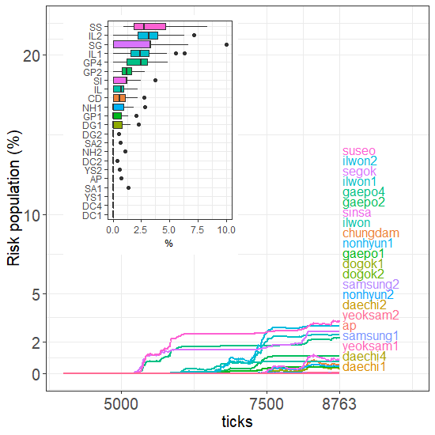
A
B
C

Slide 15
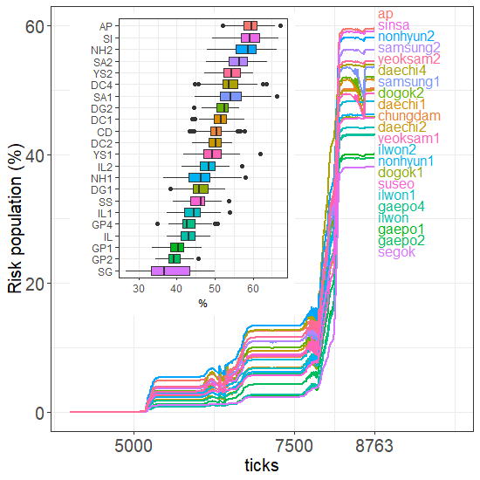
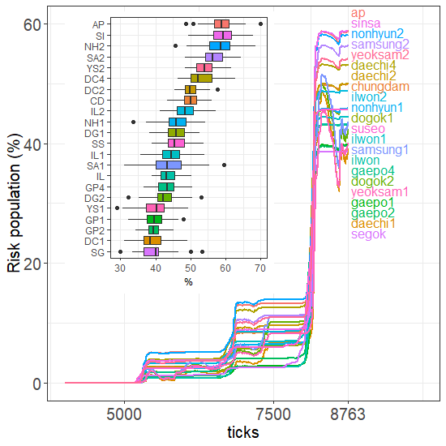
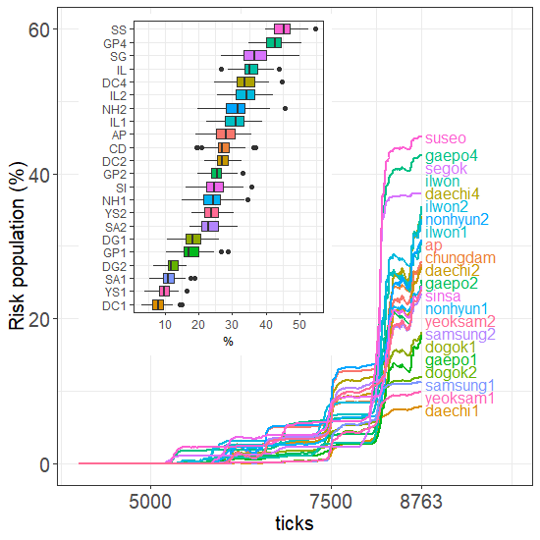
D
E
F

Slide 16
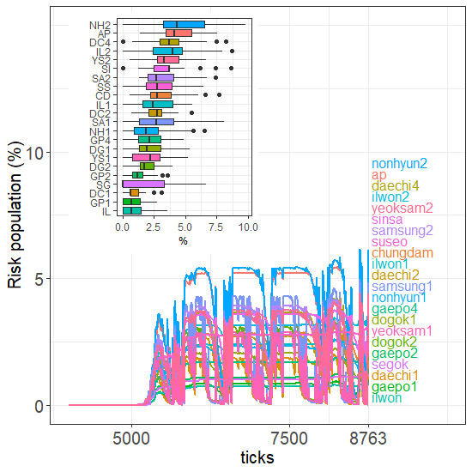
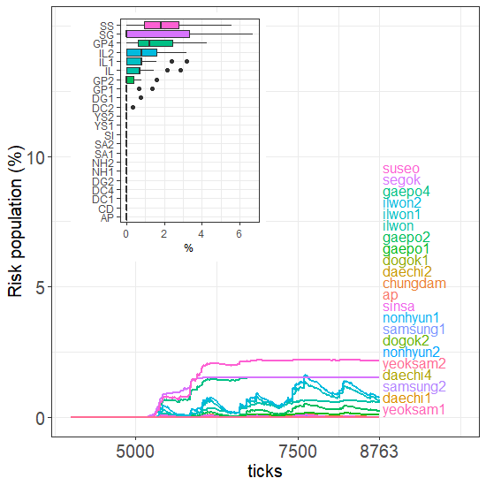
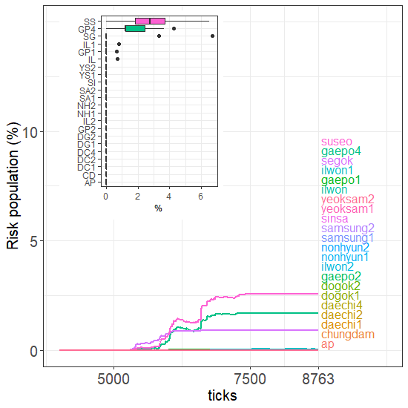
G
H
I

Slide 17
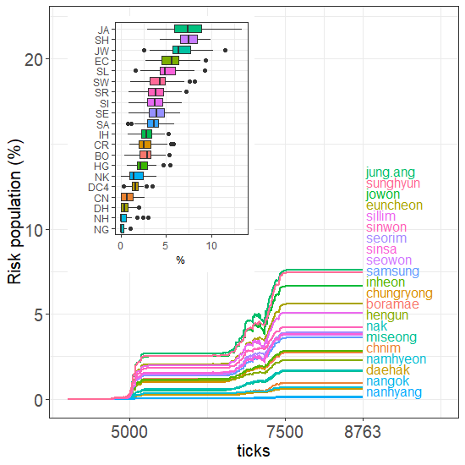
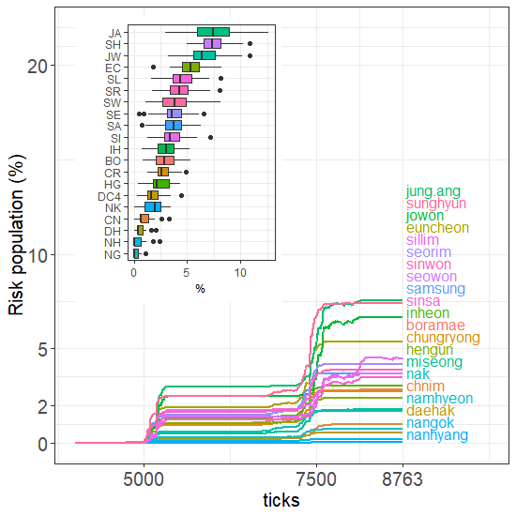
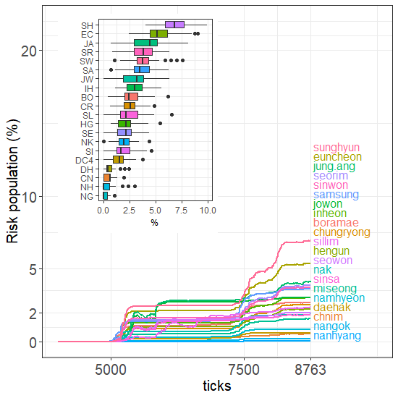
A
B
C

Slide 18
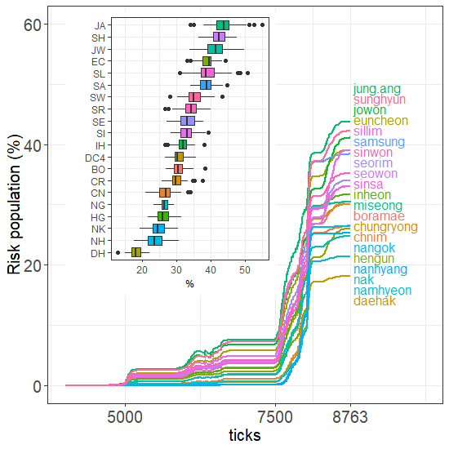
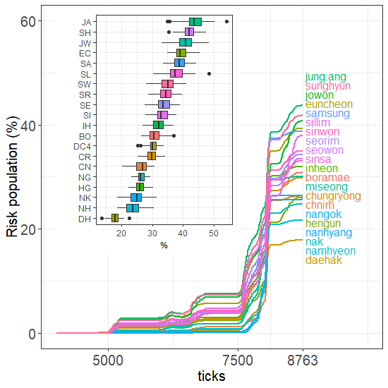
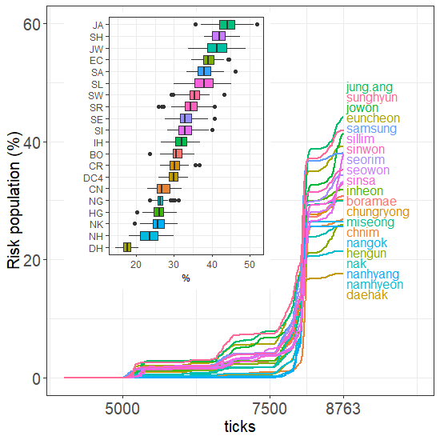
D
E
F

Slide 19
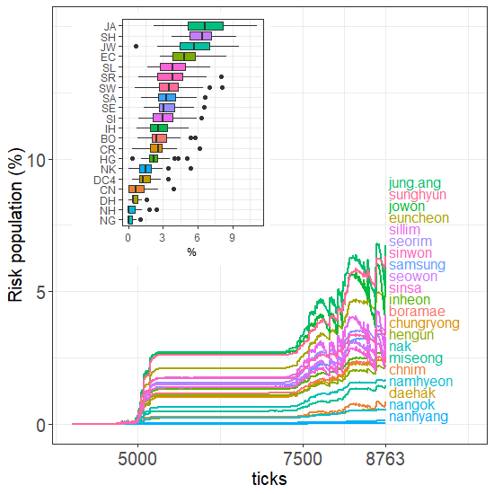
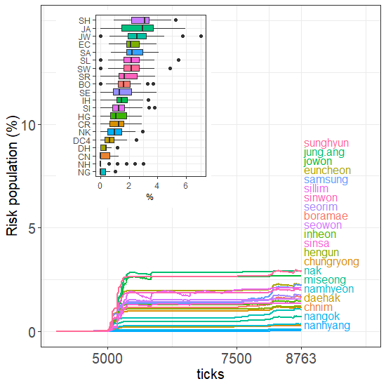
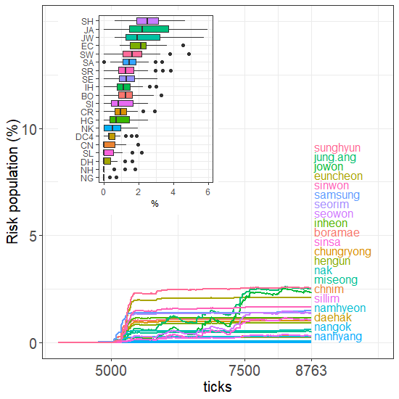
G
H
I

